Slide 1


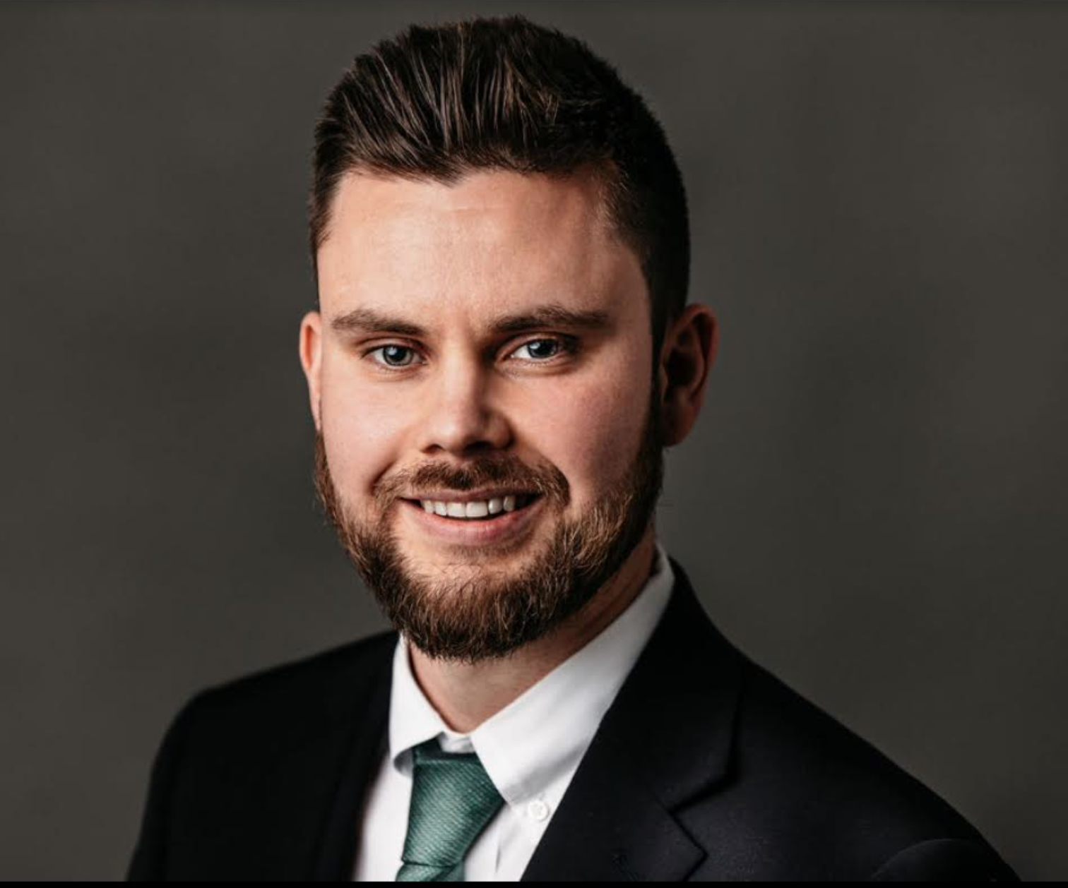

About Me,
After studying Literature at Ave Maria University, I returned to Bucks County and pursued a career in Sales and Marketing, starting with a year-long door-to-door gig with Verizon. This was followed by a career lasting nearly a decade with Comcast Business Internet/VoIP Sales performing outbound calls, managing and upselling existing accounts for small/medium-sized businesses, overseeing website operations, and eventually training new hires on systems and best practices as part of the company's mentor program. Year after year, I maintained my status as an elite salesperson, routinely making the top 25% "warm leads" teams, and pioneering new programs and technology.
Seeking to amalgamate both my lifelong passion for writing and my sales talents, I launched my own company, NPO Grant Writing, in early 2024.
Continued on next slide.
BRENDAN BRADLEY
FOUNDER
Brendan Bradley’s email address: info@npograntwriting.com
NPO Grant Writing, (2024). Retrieved from https://www.npograntwriting.com

Slide 2
After a rocky startup phase where I ironed out the kinks and established contacts with some local non-profits willing to give me a shot at writing grants for them, I applied my skills and passion in securing more than $120,000 in programmatic and general operating funding for non-profit organizations in the Greater Philadelphia area, with hundreds of thousands more in grant dollars pending approval. The momentum has been nothing short of amazing, and I look forward to helping new clients benefit from my results-driven process.
In addition to writing and communication (let's be real, you can't be a great salesperson without being a great communicator), I also have a passion for diligent research, leaving no stone left unturned when it comes to matching my non-profit clients with the most compatible funding partners; typically, Foundations and Corporations, the "low-hanging fruit” of the grant world. And that's when selling and writing come into play... selling your nonprofit's mission through excellent communication, both verbal and written. I don't believe in the myth that Grant Writing is just technical, “behind-the-scenes” writing. Grant Writing is creative writing. Grant Writing is storytelling. And most accurately, Grant Writing really just boils down to being another kind of selling.
Continued on next slide.

Slide 3
This means being face-to-face, whether that be with non-profit leadership or with funders during site visits and Zoom calls. It means communicating and being open. This is why I prefer to only work with local clients, or clients I have the opportunity to meet in person. The most effective part of the process, in my experience thus far, is not when my eyes are locked on a screen, but rather when my feet are on the ground at outreach centers and executive board rooms.
I take a hands-on approach so I can learn and be inspired as much as possible by the people I am working with. This translates to compelling grant applications. This translates into getting non-profit organizations routinely funded by true Foundation partners who want to be your partners long term, all because we sold them on your organization. Before launching my grant writing company, I took a PhD-level writing course with traditionally published author and renowned Penn Sociologist Annette Lareau to ensure my diligence in research also applied to my writing. She wrote me an enthusiastic letter of recommendation. I pride myself in having morphed myself into a writer who crafts gripping and compelling proposals--proposals that have the best chance of being well-received by funders.
What's more, my career in Sales has also taught me consistency. A "no" from a funder is not a rejection. It's a foot in the door! A "yes" from a funder is not a one-and-done deal; it's the beginning of a long-term partnership involving more-frequent and higher-dollar grant awards over time. My journey to becoming an NPO Grant Writer is an unconventional one. But it's also a powerful one filled with early success and momentum that I know will continue. I look forward to shaking up this industry as well as knocking it out of the park for your non-profit, getting you the funding you need to thrive.
Please review the following slides. They represent the same “Funding Strategy” / “Grants Management Hub” I will build for all my clients.
Brendan Bradley’s email address: info@npograntwriting.com

Slide 4
Opportunities Won (for a current retainer client)

Slide 5
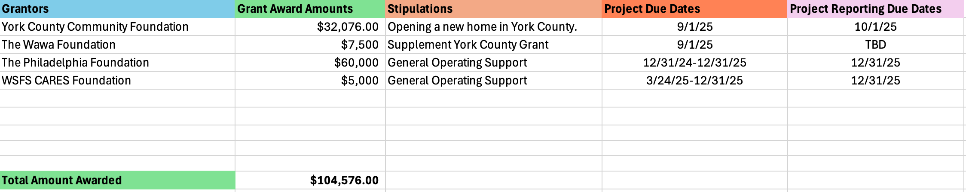
Emmaus Home Excel Grant Tracker
Client Grant Tracker

Slide 6
Funding Partners
Shortcuts
Shortcuts: ctrl+click or view in slideshow
York County Community Foundation
The Wawa Foundation
The Philadelphia Foundation
WSFS CARES Foundation
1.
2.
3.
4.

Slide 7

Memorial Health Fund Grant
✓Awarded
York County Community Foundation, (2024). Retrieved from https://yccf.org

Slide 8

Memorial Health Fund
This grant program seeks to transform the way our community addresses compelling health issues by funding programs that improve the complete physical, mental, and social well-being of the residents of York and its surrounding communities. The Memorial Health Fund competitive grant program is designed to be flexible.
York County Community Foundation, (2024). Retrieved from https://yccf.org

Slide 9

Grant Application Cycles
2024
2025
Double click Word Doc to view application
Amount Awarded: $32,076.00

Slide 10
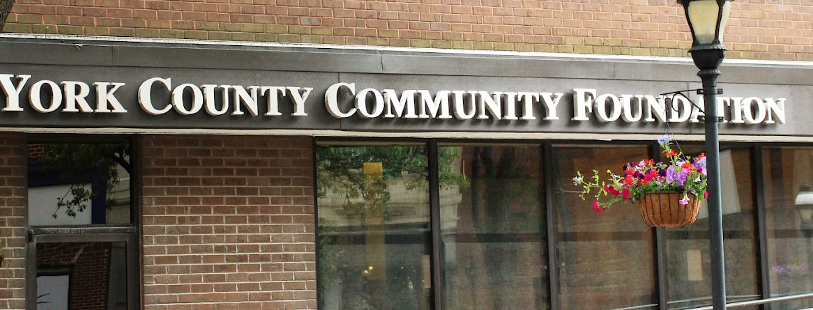
Address: 14 West Market Street, York, Pa 17401
Date and time of Photo OP: April 15th, 2025, 1-4 PM. Complete
Status Update: Six-month extension on project approved.

Slide 11
Applications & Deadlines
Important Dates
Project/Expenditure Start Date: TBD
Expected Completion Date: 9/01/2025
Post Grant Report: 10/01/2025
Award Letter (Double click Word Doc to view)

Slide 12
Learn More
Back to Grants Slide
Click here for more information.

Slide 13


Philadelphia Foundation
✓Awarded
The Philadelphia Foundation, (2025). Retrieved from https://www.philafound.org

Slide 14
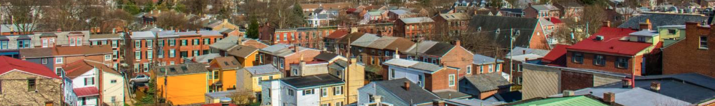
About the Philadelphia Foundation
We work with givers to establish funds that fulfill their philanthropic goals most effectively. With a broad set of giving tools available, we help givers create a strategic plan for their philanthropic assets that will create the greatest possible community impact. Our team of experts brings unmatched knowledge of the region’s most critical needs and the nonprofits addressing those needs.
Aside from serving as good stewards of our philanthropic funds, we are committed to improving the quality of life in our great region in several ways:
Distributing grants and resources to our region’s most effective nonprofits
Establishing and distributing scholarships
Pairing skilled volunteers with important community initiatives through our partnerships
Serving as a civic voice and leader in Greater Philadelphia

Slide 15
About the Philadelphia Foundation
Fields of work
Poverty Alleviation & Services Basic Human NeedsHuman & Social Services
WEBSITE: https://www.philafound.org/nonprofits/available-grants/impact-grants/
Location of residency: Counties in New Jersey: Burlington County, Camden County, Counties in Pennsylvania: Bucks County, Chester County, Delaware County, Montgomery County, Philadelphia Countyhttps://www.philafound.org/nonprofits/available-grants/impact-grants/

Slide 16
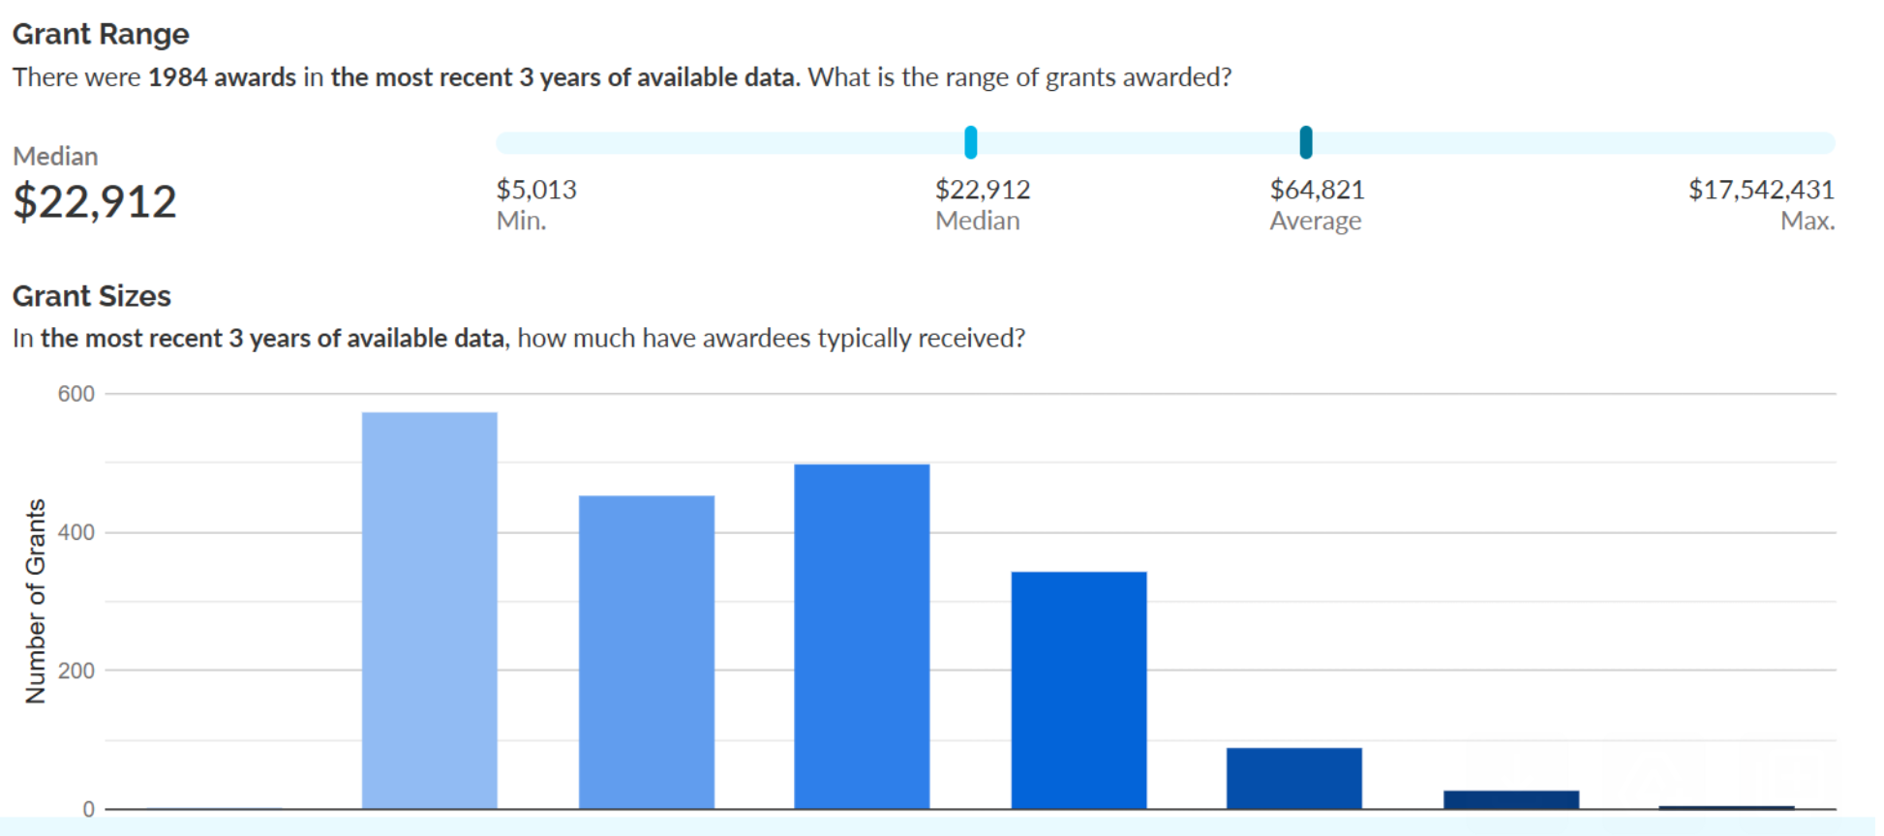
Grant Sizes

Slide 17
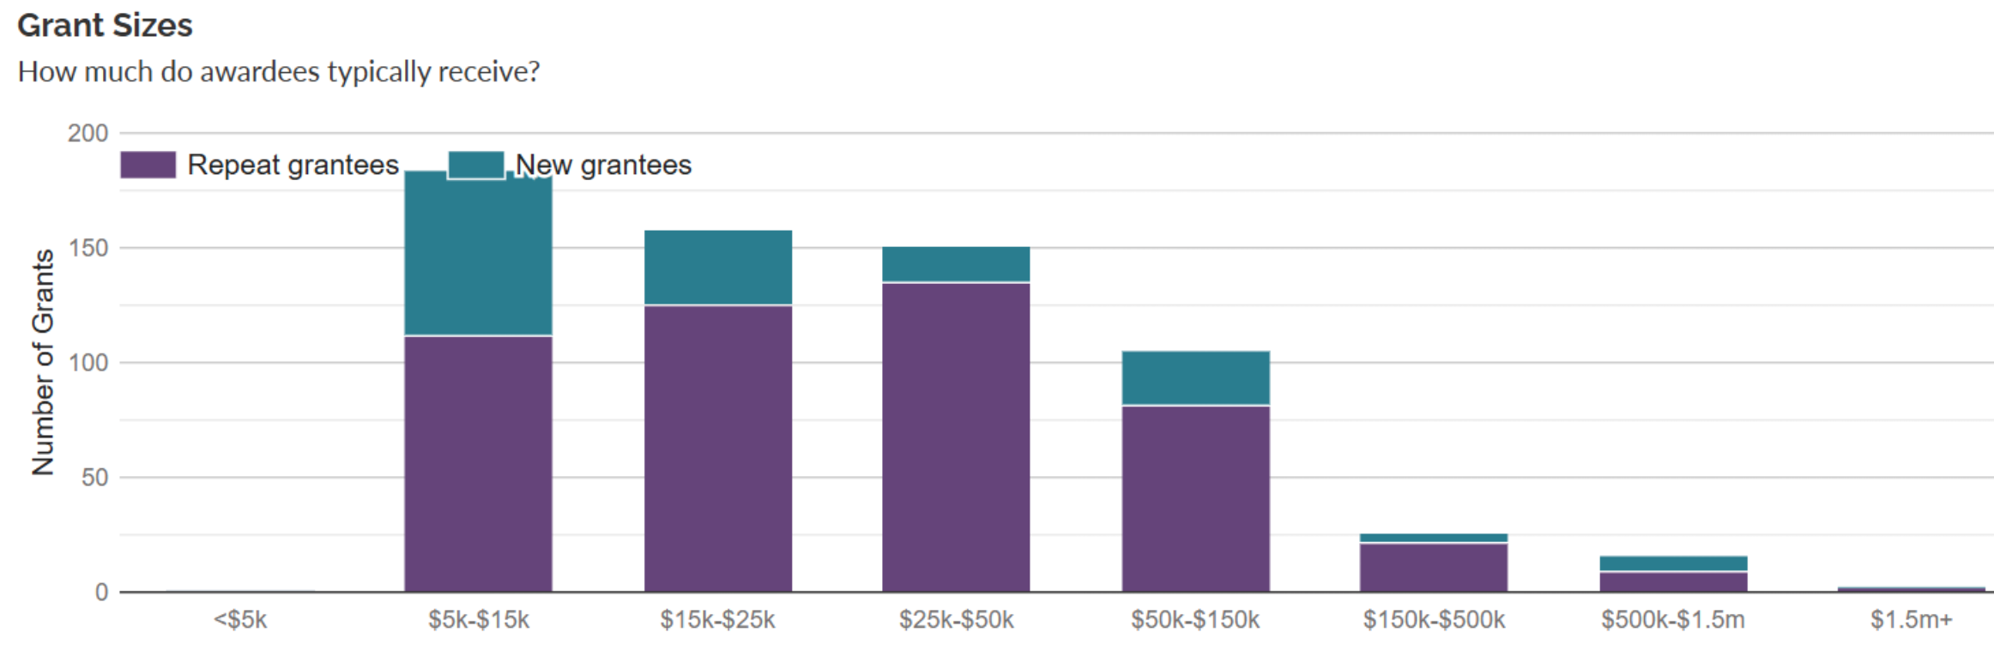
Grant Sizes

Slide 18
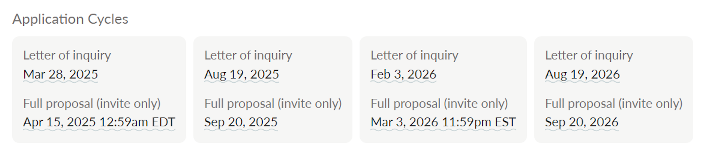
Application Cycles

Slide 19
Grant Details
$30,000
Grant Amount
Award Letter

Slide 20
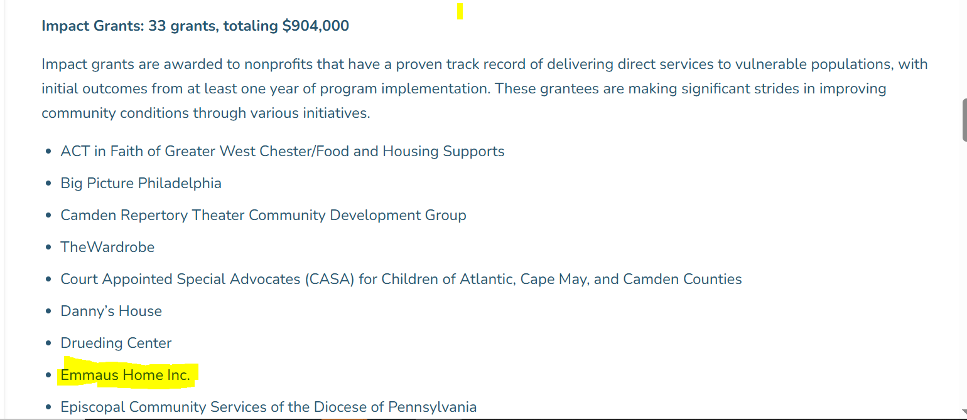
Philadelphia Foundation April 2025 Update: We know our communities need flexible support now. As a result, Philadelphia Foundation will be making unrestricted, general operating support grants to most organizations that received our Competitive Grants in 2024. If your organization is a 2024 Grantee, our grants team will communicate its recommendation and next steps via email to your Executive Director by April 30, 2025.
ATTENTION
Grant Award = Doubled!! A perfect demonstration of why non-profits need these lucrative partnerships.

Slide 21
Applications & Deadlines
Completed Application
December 2024
Total Amount Won: $60,000 in general operating support.

Slide 22


Contact Info
.
Sheressa Gordon
Manager, Grantmaking Operations
215-863-8122
Philadelphia Foundation
1835 Market Street, Suite 2410
Philadelphia, PA 19103
Back to Grants Slide

Slide 23

Wawa Foundation Financial Grants Over $2,500 Average Grant Amount: $59,000
✓Awarded
The Wawa Foundation, (2024). Retrieved from https://www.thewawafoundation.org/our-focus-and-impact/types-of-support/

Slide 24
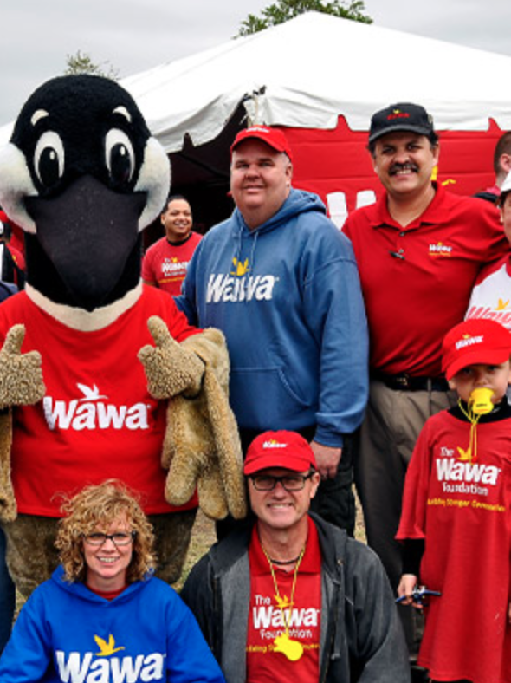
About The Wawa Foundation
The Wawa Foundation provides financial grants on a local, regional and national level ensuring that our commitment extends from the local communities Wawa serves to the regional footprint Wawa occupies in the mid-Atlantic and Florida.
Only registered 501(c)(3) non-profit organizations operating in Wawa’s six-state area are eligible to apply.
Organizations must fall into The Wawa Foundation’s three key areas of focus: Health, Hunger and Everyday Heroes.
The Wawa Foundation, (2024). Retrieved from https://www.thewawafoundation.org/our-focus-and-impact/types-of-support/

Slide 25
Grant Contact: The Wawa Foundation
Email address: TheWawaFoundation@wawa.com
(Pending Meeting Request)
The Wawa Foundation, (2024). Retrieved from https://www.thewawafoundation.org/our-focus-and-impact/types-of-support/

Slide 26
Application Cycles
30 Apr. 2024
Apr 30, 2024
31 July 2024
Jul 31, 2024
31 Oct. 2024
Oct 31, 2024
31 Jan. 2025
Jan 31, 2025
The Wawa Foundation, (2024). Retrieved from https://www.thewawafoundation.org/our-focus-and-impact/types-of-support/

Slide 27

Eligibility
The Wawa Foundation, (2024). Retrieved from https://www.thewawafoundation.org/our-focus-and-impact/types-of-support/
The Wawa Foundation provides support to 501(c)(3) nonprofit organizations within Wawa’s six-state market area of Pennsylvania, New Jersey, Delaware, Maryland, Virginia, Florida and the District of Columbia.
The Wawa Foundation supports organizations making a difference in our focus areas of health, hunger, and everyday heroes.

Slide 28



Learn More
You can learn more about this opportunity by visiting the funder's website.
The Wawa Foundation, (2024). Retrieved from https://www.thewawafoundation.org/our-focus-and-impact/types-of-support/

Slide 29
Wawa
Completed Grant Application
Total Grant Amount: +$7,500 in supplemental programmatic support

Slide 30
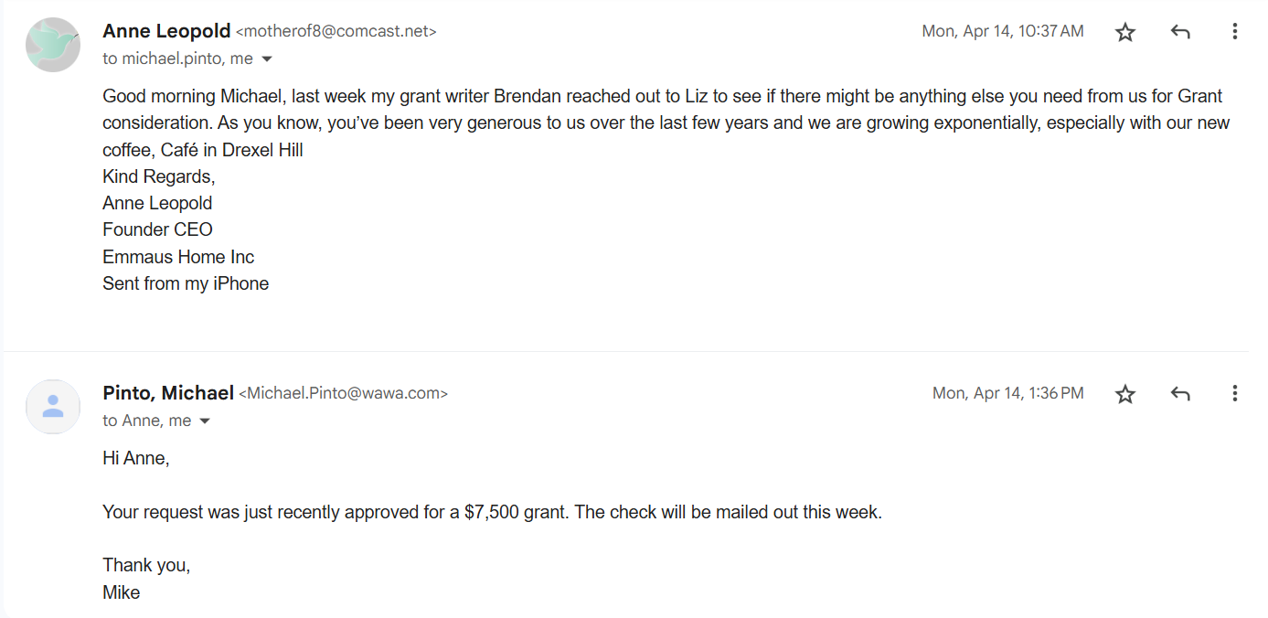

Slide 31
Wawa
Status Update
Wawa status update: The funds were approved for community participation support in York County. Specifically, around the efforts to open an additional community-integrated group home.
Can apply again in Jan 2026. Personal Contact: Michael.pinto@wawa.com
Back to Grants Slide

Slide 32


WSFS Foundation Grant
✓APPROVED
WSFS Bank, Member FDIC, (2024). Retrieved from https://www.wsfsbank.com/about/community/the-wsfs-cares-foundation/

Slide 33
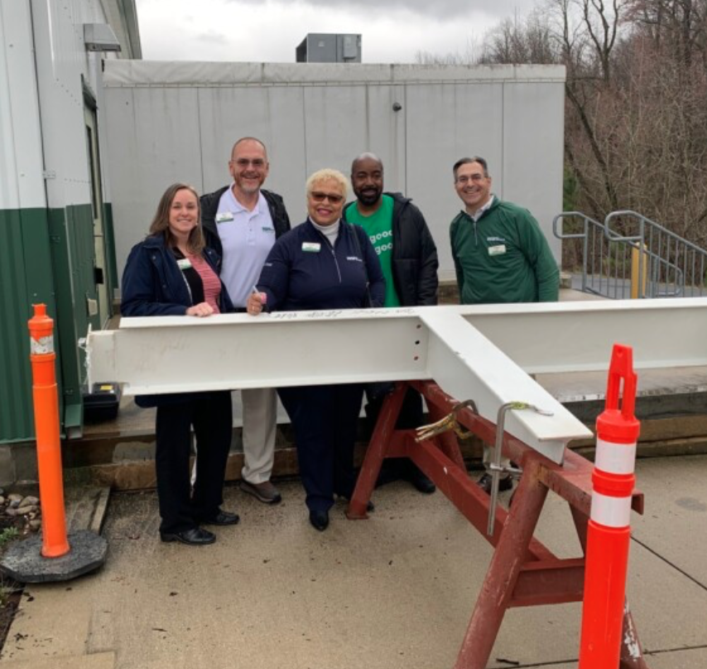
About the WSFS Grant
We envision a world in which all of our community members are given an equal opportunity to succeed. Our communities will be enriched by our philanthropic efforts, personal commitment to service, and intentional desire to assist those in need that lead to a better life.
Grants are awarded for initiatives that are innovative, creative, sustainable and replicable.
WSFS Bank, Member FDIC, (2024). Retrieved from https://www.wsfsbank.com/about/community/the-wsfs-cares-foundation/

Slide 34
WSFS Foundation
Applicant type: Nonprofit
Funding uses: Education/Outreach, Project/ Program
Location of project: Matches: Bucks County Other eligible locations: Delaware, Counties in Pennsylvania: Adams County, Berks County, Chester County, Cumberland County
Location of residency: United States
WSFS Bank, Member FDIC, (2024). Retrieved from https://www.wsfsbank.com/about/community/the-wsfs-cares-foundation/

Slide 35

Eligibility
The WSFS CARES Foundation supports qualified nonprofit organizations that are invested in improving communities, fostering a spirit of inclusion and diversity, and whose focus aligns with our transformational vision.
Services for Those in Need
WSFS contributes to organizations that protect the health of those who live within our communities and are least able to afford the health care services they need. We support food banks, educational and counseling programs to help promote healthy lifestyles, and offer services to people with disabilities and special needs.
WSFS Bank, Member FDIC, (2024). Retrieved from https://www.wsfsbank.com/about/community/the-wsfs-cares-foundation/

Slide 36
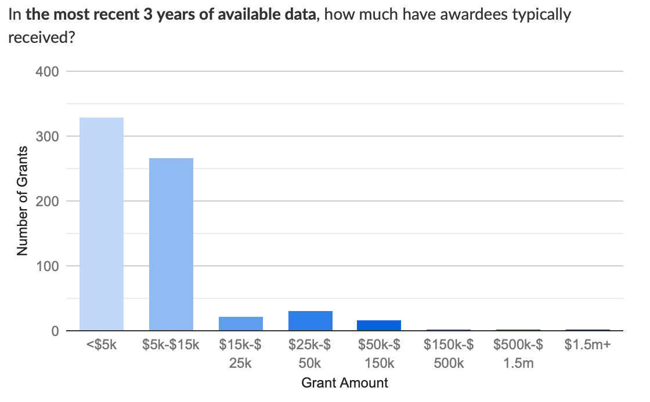
Grant Sizes
WSFS Bank, Member FDIC, (2024). Retrieved from https://www.wsfsbank.com/about/community/the-wsfs-cares-foundation/

Slide 37
Applications & Deadlines
Contact Information
Important Dates
Vernita Dorsey
Email address:(vdorsey@wsfsbank.com)
M: 302-981-6870
O: 302-571-5277
Award Amount: $5,000, general operating support
Site visit? YES (1/28/25)
Application: Completed

Slide 38
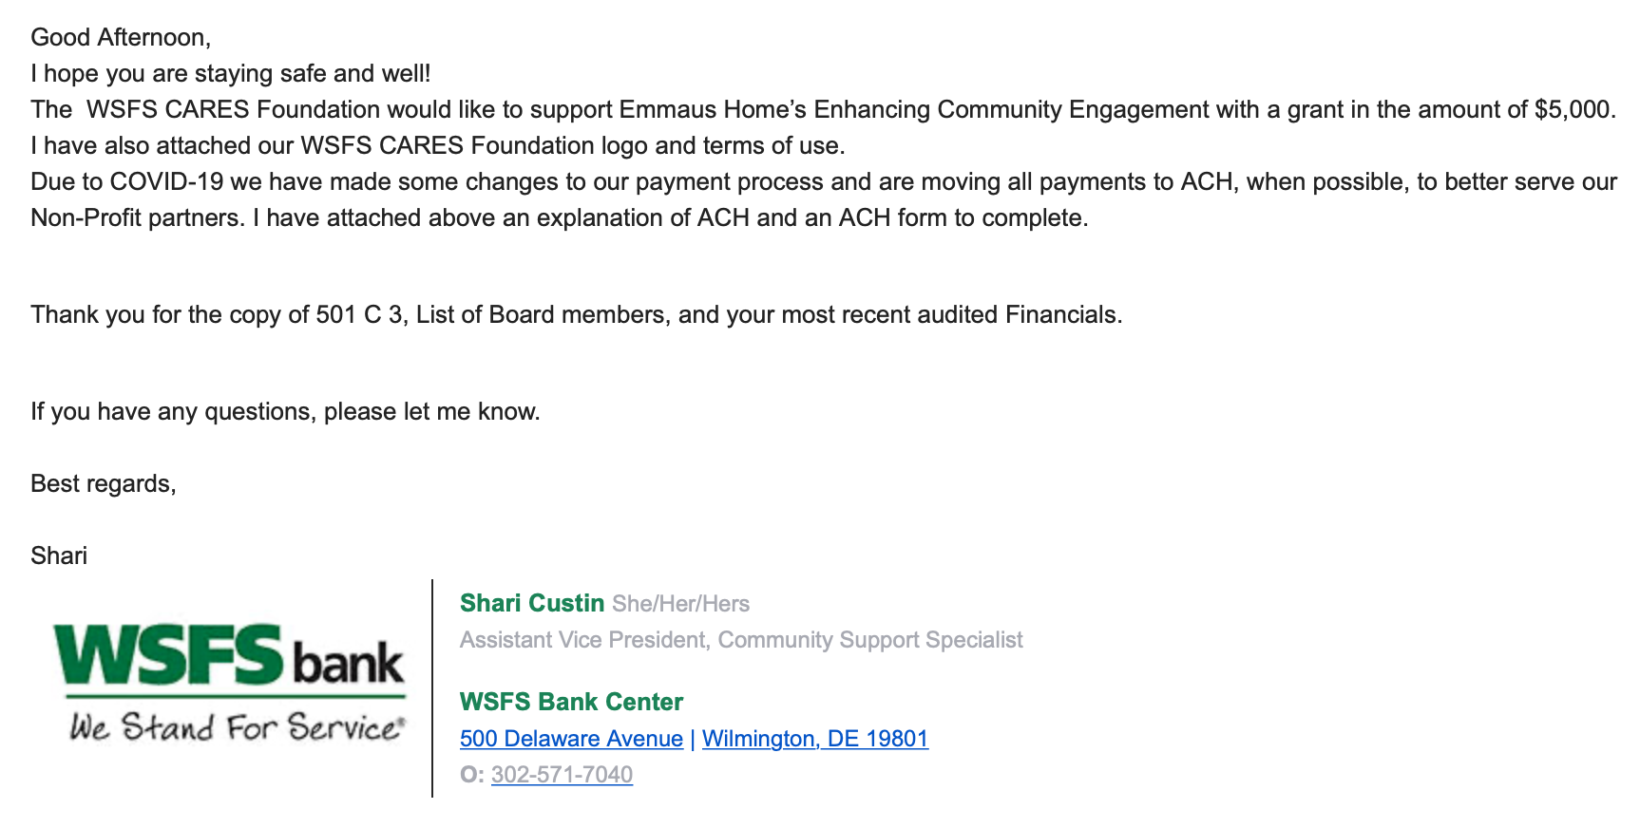

Slide 39
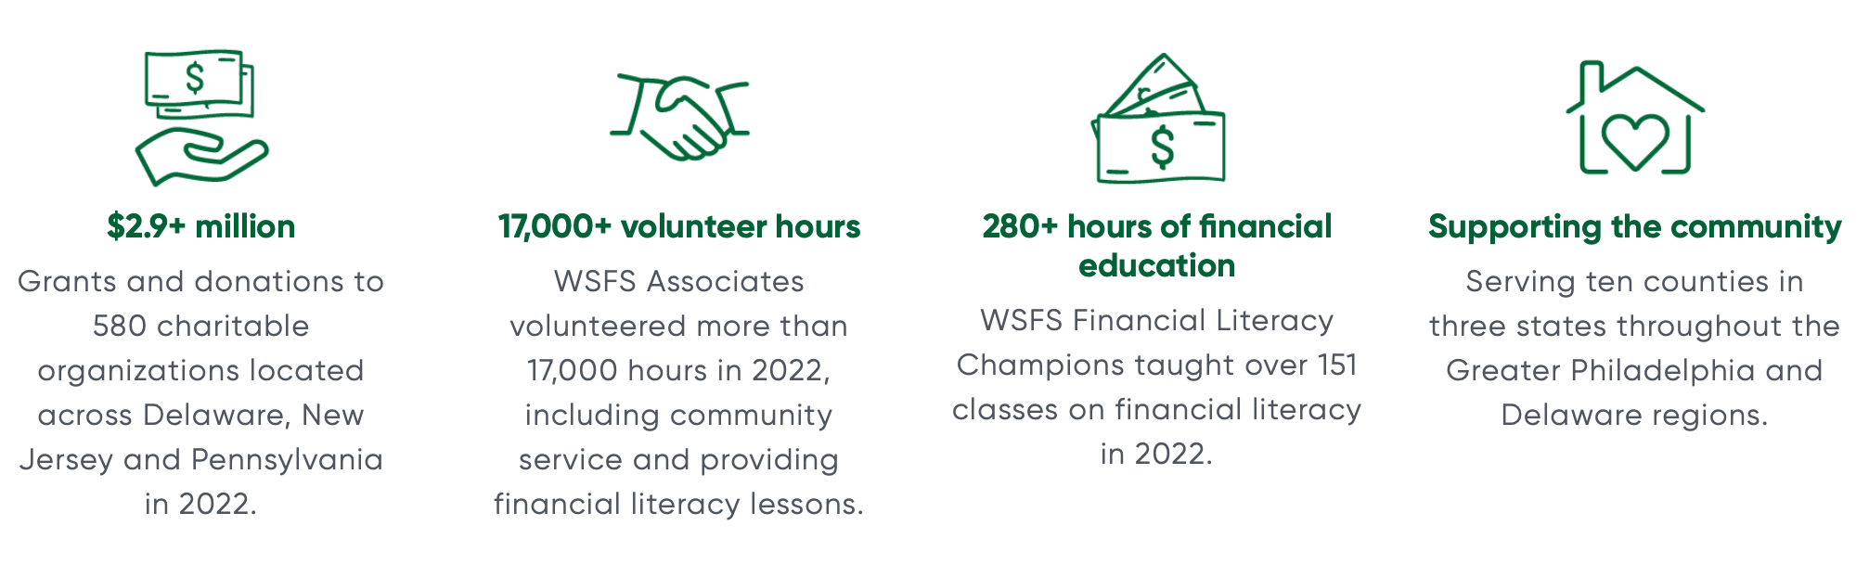
Learn More
Click here to learn more.
WSFS Bank, Member FDIC, (2024). Retrieved from https://www.wsfsbank.com/about/community/the-wsfs-cares-foundation/
Back to Grants Slide

Slide 40
Pending Opportunities (Over $1M in potential funding!).
Shortcuts
Slides not included for sake of brevity
1. Powder Mill Foundation
2. TD Bank
3. CPPS Heritage Mission Fund
4. Bucks County Foundation
5. Bucks County Community Foundation
6. Hearst Foundations
7. PNC Foundation
8. Stewart Huston Foundation Charitable Trust
9. Sidney Stern Memorial Trust
10. True Inspiration Awards
11. Eide Bailly Resourcefullness Award
12. Wegmans
13. Kimberton

Slide 41

Thank you for reviewing this sample material,
NPO Grant Writing
All information contained in this Sample PowerPoint was approved for sharing by client

